Slide 1
JavaScript Essentials
Variables

Slide 2
Table of Contents
Overview
Declare a variable
Initialize a variable
Update a variable
Naming variables
Value types
Dynamic typing

Slide 3

Lesson Objectives
Understand what is a variable ?
Able to declare variable to solve common problem
Understand 6 value types of data in JavaScript
Understand dynamic typing in JavaScript

Slide 4
Overview
Section 1

Slide 5
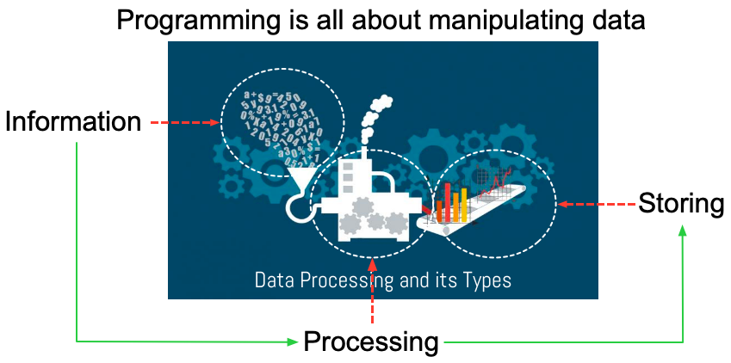
Overview – Data and Variable
Notes:
Programming is all about manipulating data, but what is data? Data is information that we store in our computer programs.
For example, your name is a piece of data, and so is your age.
The color of your hair, how many siblings you have, where you live, whether you’re male or female—these things are all data.

Slide 6
Overview – Variable
JavaScript lets you give names to values using variables
You can think of a variable as a box that you can fit one thing in
If you put something else in it, the first thing goes away.

Slide 7
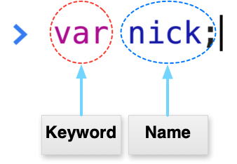
Overview – Declare a variable
Notes:
To create a new variable, use the keyword var, followed by the name of the variable.
A keyword is a word that has special meaning in JavaScript. In this case, when we type var, JavaScript knows that we are about to enter the name of a new variable. For example, here’s how you’d make a new variable called nick:
var nick;
undefined
We’ve created a new variable called nick. The console spits out undefined in response. But this isn’t an error! That’s just what JavaScript does whenever a command doesn’t return a value. What’s a return value? Well, for example, when you typed 12345 + 56789;, the console returned the value 69134.
Creating a variable in JavaScript doesn’t return a value, so the interpreter prints undefined.

Slide 8
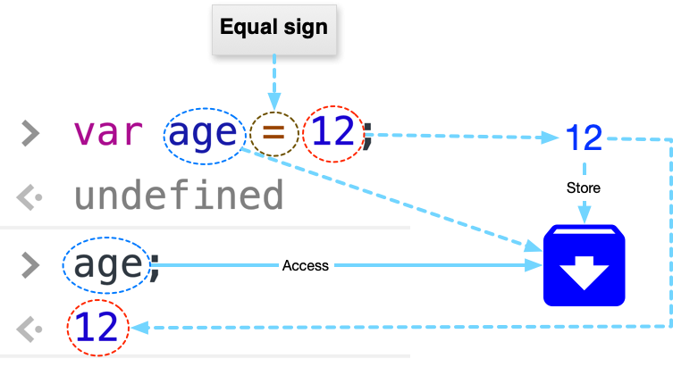
Overview – Initialize a variable
Notes:
To give the variable a value, use the equal sign:
var age = 12;
undefined
Setting a value is called assignment (we are assigning the value 12 to the variable age). Again, undefined is printed, because we’re creating another new variable. (In the rest of my examples, I won’t show the output when it’s undefined.)
The variable age is now in our interpreter and set to the value 12. That means that if you type age on its own, the interpreter will show you its value:
age;
12

Slide 9
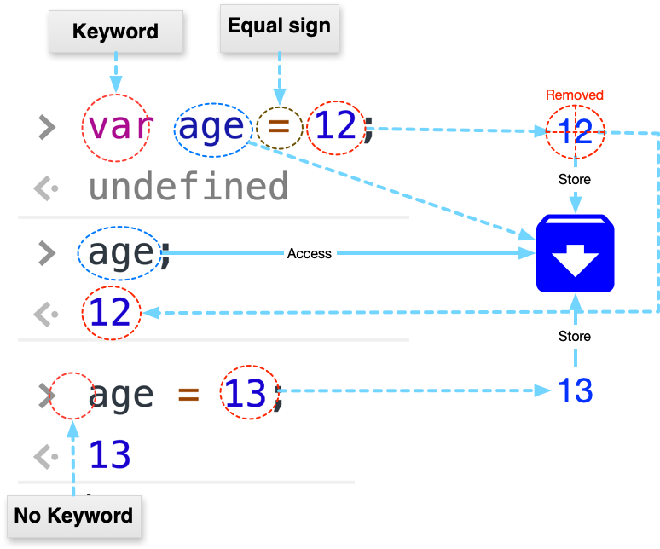
Overview – Update a variable
Notes:
Cool! The value of the variable isn’t set in stone, though (they’re called variables because they can vary), and if you want to update it, just use = again:
age = 13;
13
This time I didn’t use the var keyword, because the variable age already exists. You need to use var only when you want to create a variable, not when you want to change the value of a variable. Notice also, because we’re not creating a new variable, the value 13 is returned from the assignment and printed on the next line.
This slightly more complex example solves the candies problem from earlier, without parentheses:
var numberOfSiblings = 1 + 3; var numberOfCandies = 8; numberOfCandies / numberOfSiblings; 2
First we create a variable called numberOfSiblings and assign it the value of 1 + 3 (which JavaScript works out to be 4). Then we create the variable numberOfCandies and assign 8 to it. Finally, we write numberOfCandies / numberOfSiblings. Because numberOfCandies is 8 and numberOfSiblings is 4, JavaScript works out 8 / 4 and gives us 2.

Slide 10
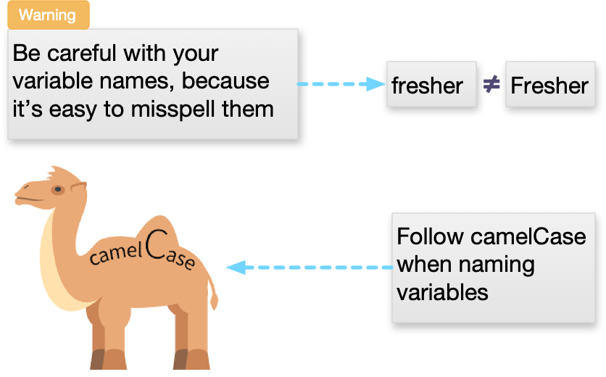
Overview – Naming Variables

Slide 11
Overview – Demo
Demo: Create new variable using Math
Notes:
Seconds in a hour:
var secondsInAMinute = 60; var minutesInAnHour = 60; var secondsInAnHour = secondsInAMinute * minutesInAnHour;
secondsInAnHour;
Seconds in a Day
var hoursInADay = 24;
var secondsInADay = secondsInAnHour * hoursInADay;
secondsInADay;
Seconds in a Year
var daysInAYear = 365; var secondsInAYear = secondsInADay * daysInAYear;
Age in Seconds
var age = 29; age * secondsInAYear;

Slide 12
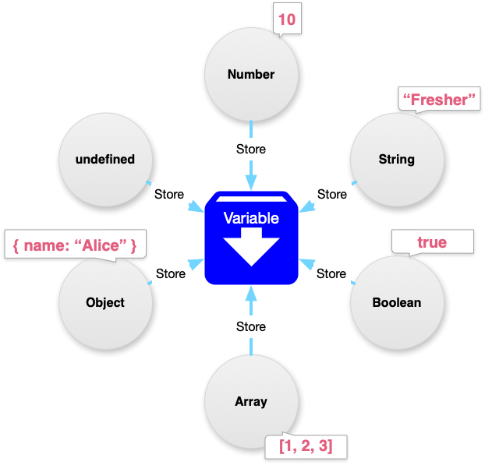
Overview – Data types

Slide 13
Overview – Dynamic typing
JavaScript is a "dynamically typed language"
You don't need to specify what data type a variable will contain (numbers, strings, arrays, etc)
Use typeof operator to get the data type of variable contain
Be careful when working with dynamic typing language
Notes:
Dynamic typing
JavaScript is a "dynamically typed language", which means that, unlike some other languages, you don't need to specify what data type a variable will contain (numbers, strings, arrays, etc).
For example, if you declare a variable and give it a value enclosed in quotes, the browser treats the variable as a string:
let myString = 'Hello';Even if the value contains numbers, it is still a string, so be careful:
let myNumber = '500'; // oops, this is still a string typeof myNumber; myNumber = 500; // much better — now this is a number typeof myNumber;
Try entering the four lines above into your console one by one, and see what the results are. You'll notice that we are using a special operator called typeof — this returns the data type of the variable you type after it. The first time it is called, it should return string, as at that point the myNumber variable contains a string, '500'. Have a look and see what it returns the second time you call it.

Slide 14
Overview – Summary
Programming is all about manipulating of data
We manipulate data with variable
Variable is a container for data
By combining multiple operators on variable, we can create more complex value
In JavaScript, you must take care of variable data types else your program will not behave like you expected

Slide 15

Thank you
Q&A

